Slide 1
Part One…
One Small Step

Slide 2
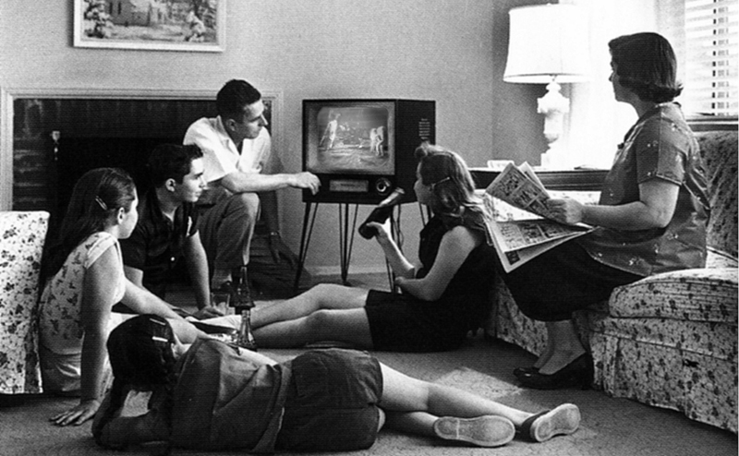
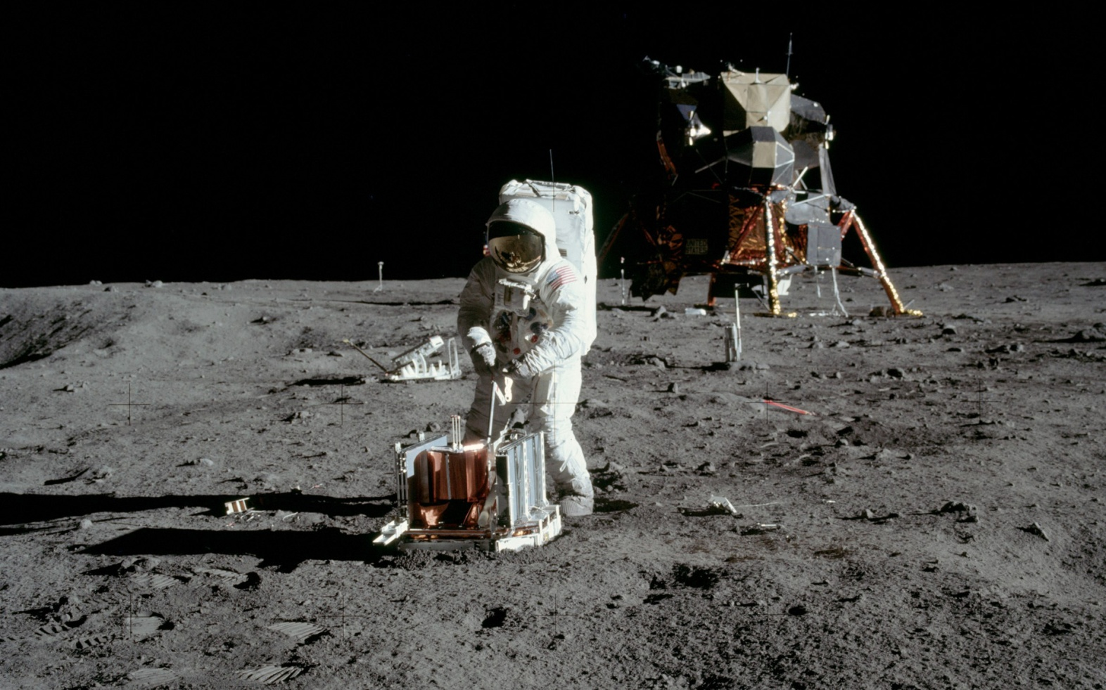

Slide 3
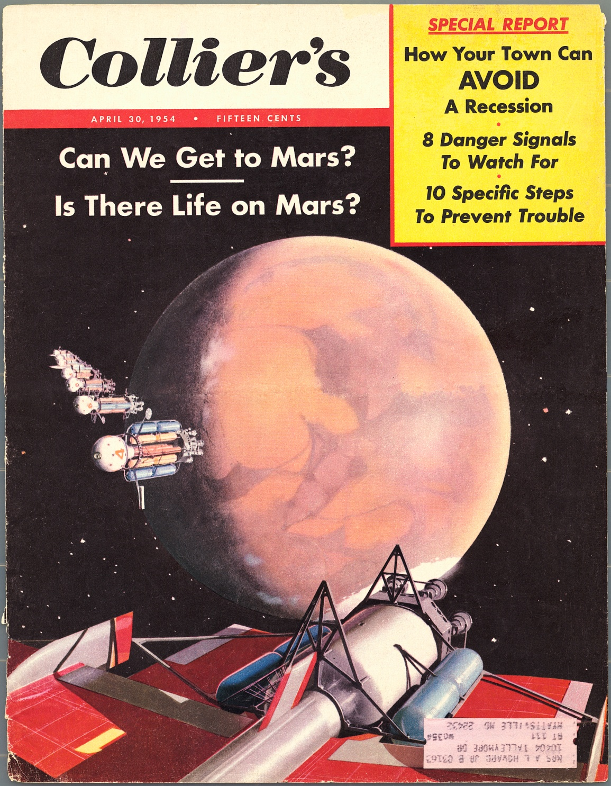
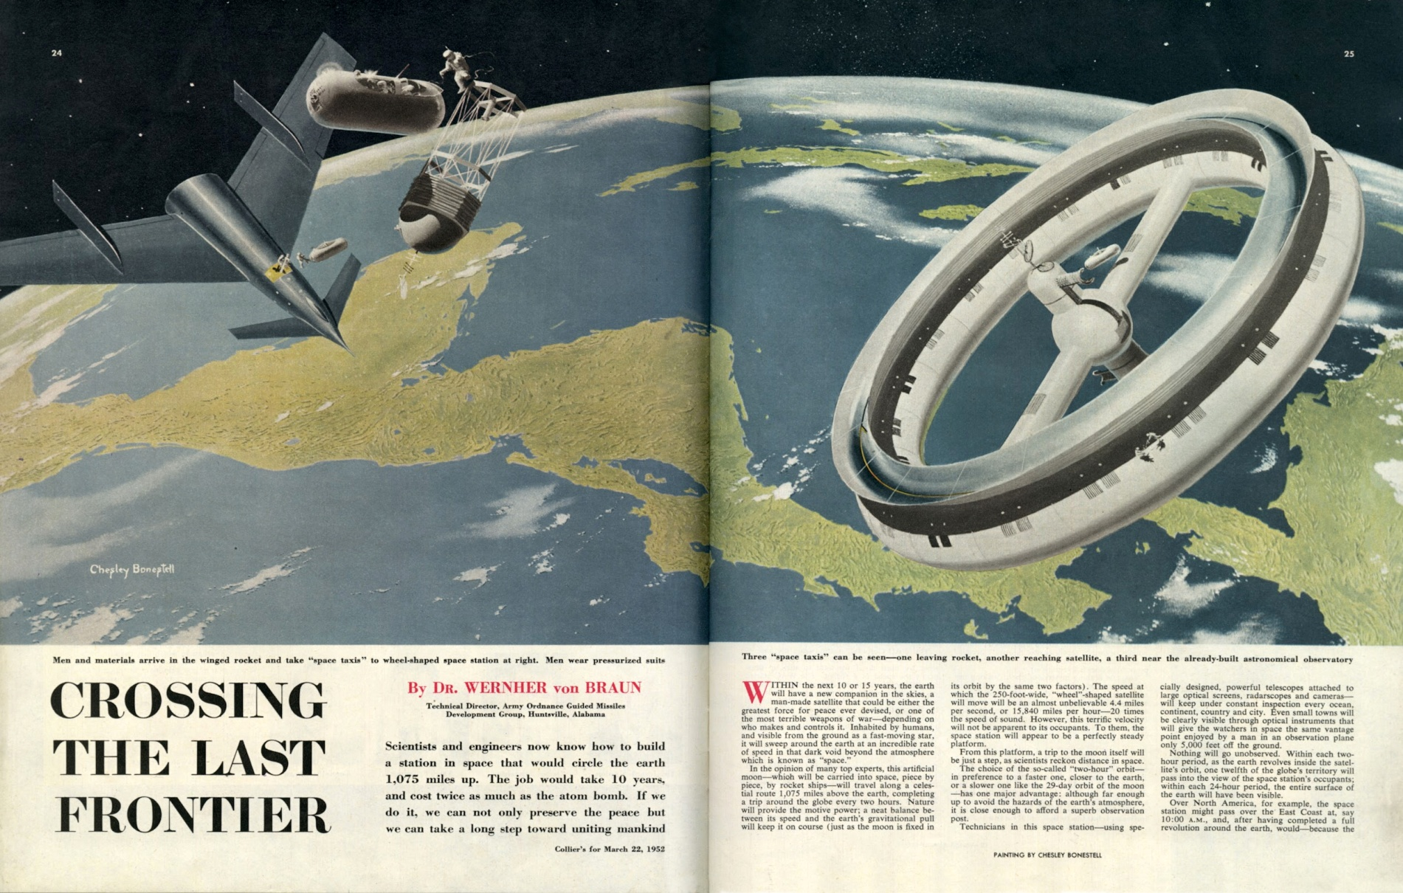
Our bright future in space… from 1952!
Credit: Dreams of Space Books & Ephemera

Slide 4
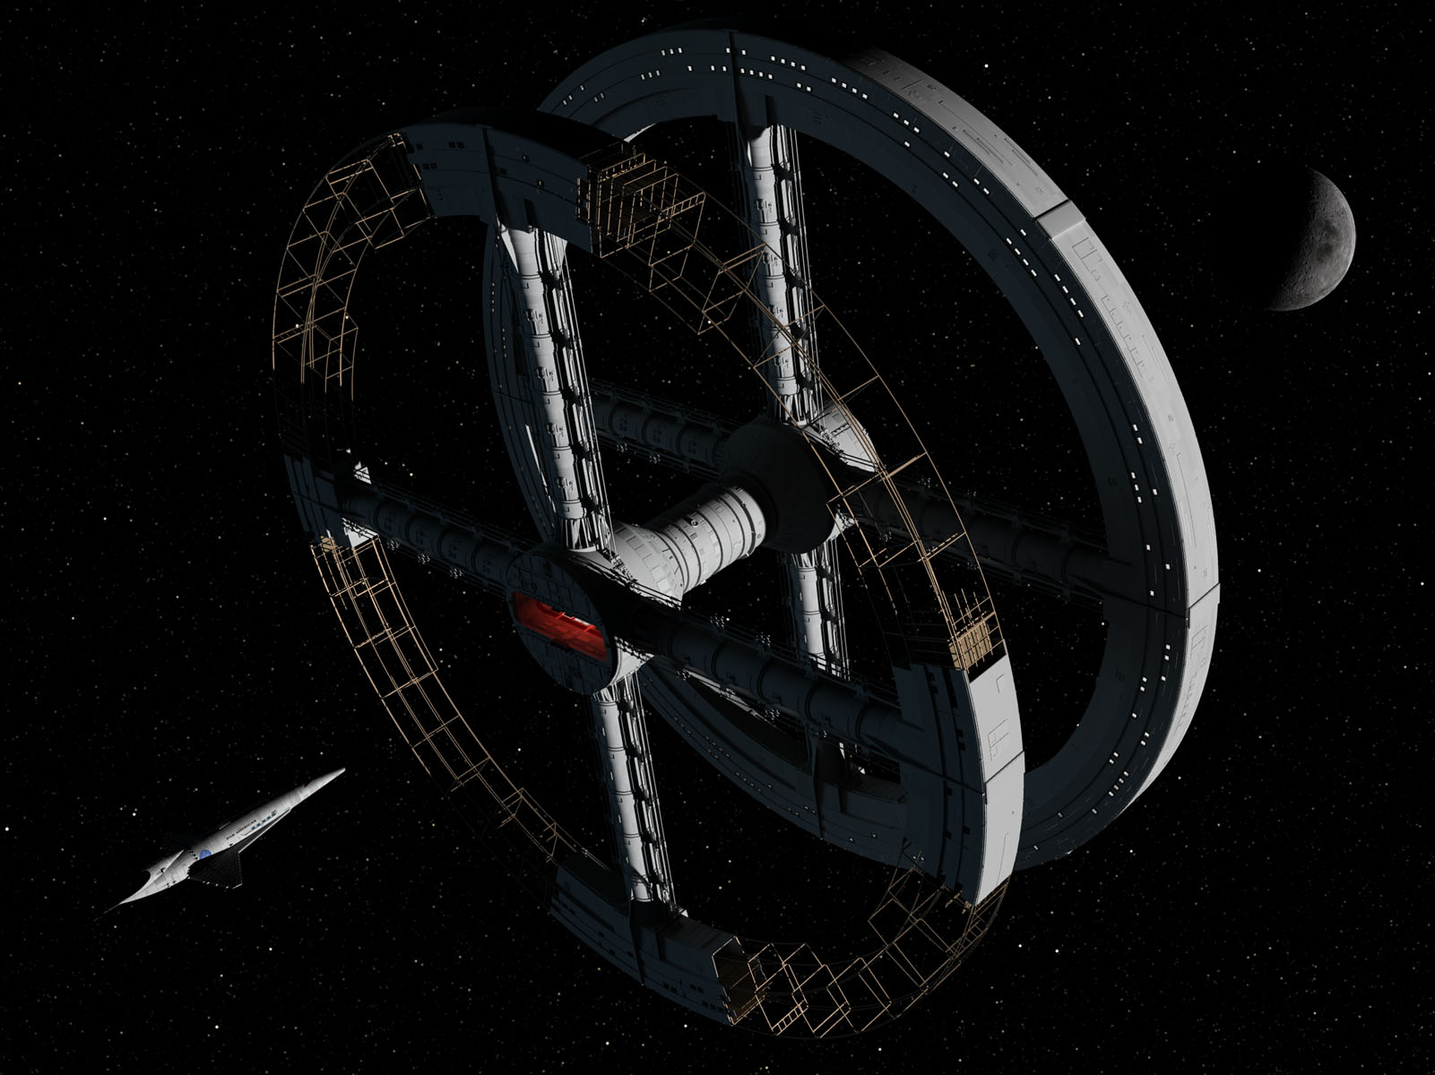
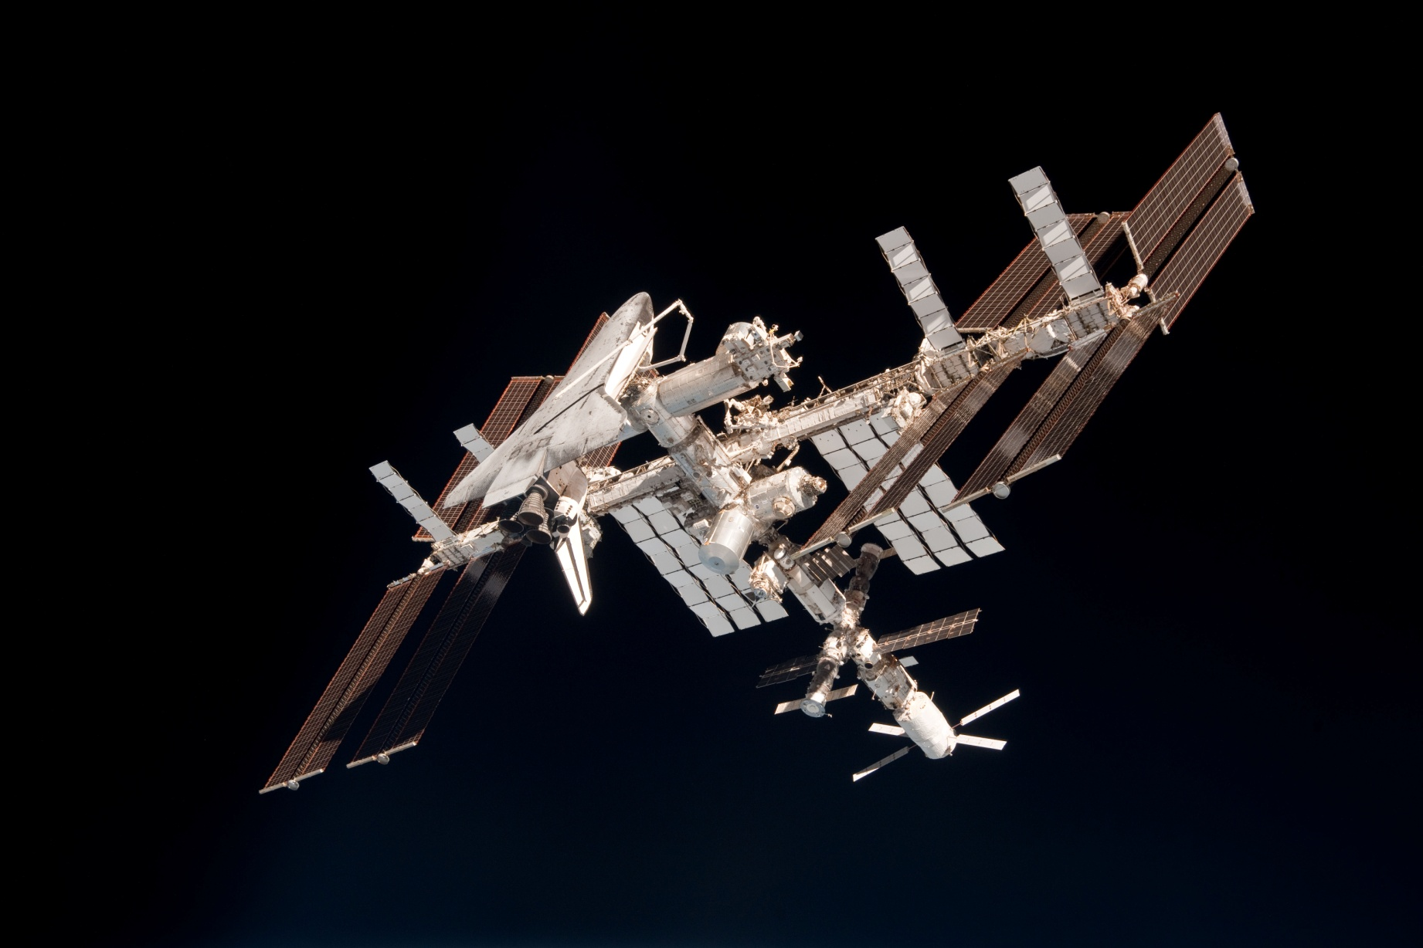
And not this…
As 1968 saw our future in 2001
...2011
Credit: International Space Art Network, NASA

Slide 5
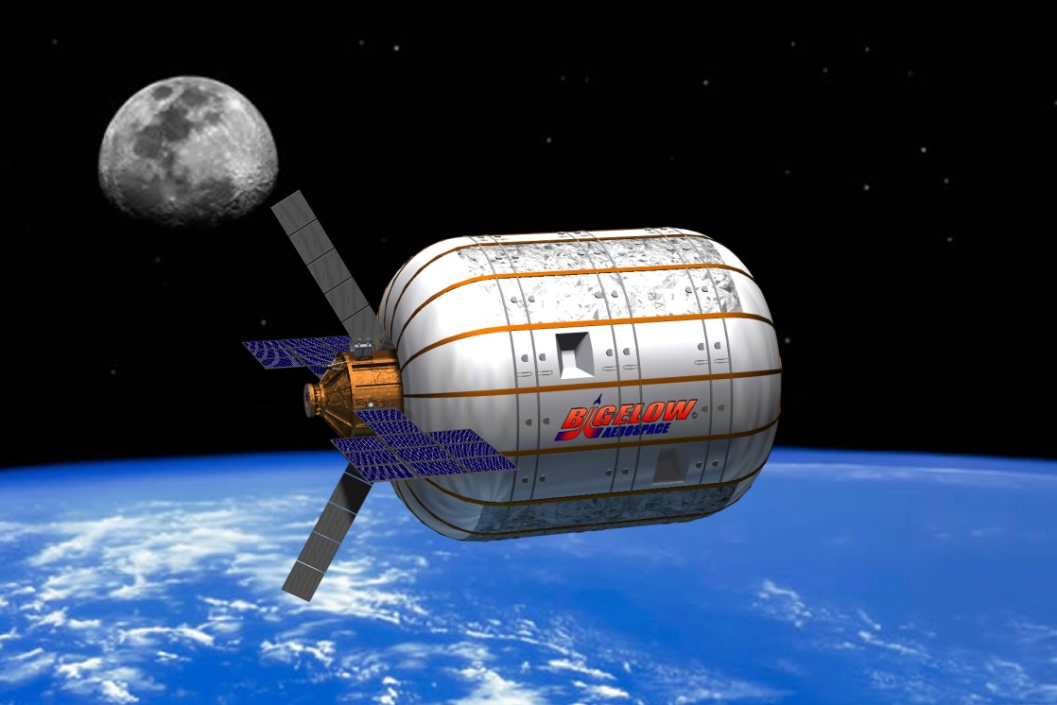
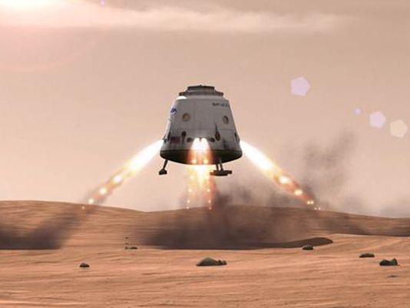
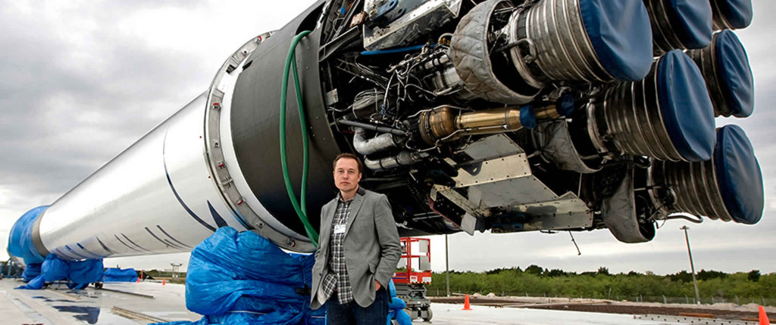
New
Space
Credits: Bigelow Aerospace, SpaceX

Slide 6
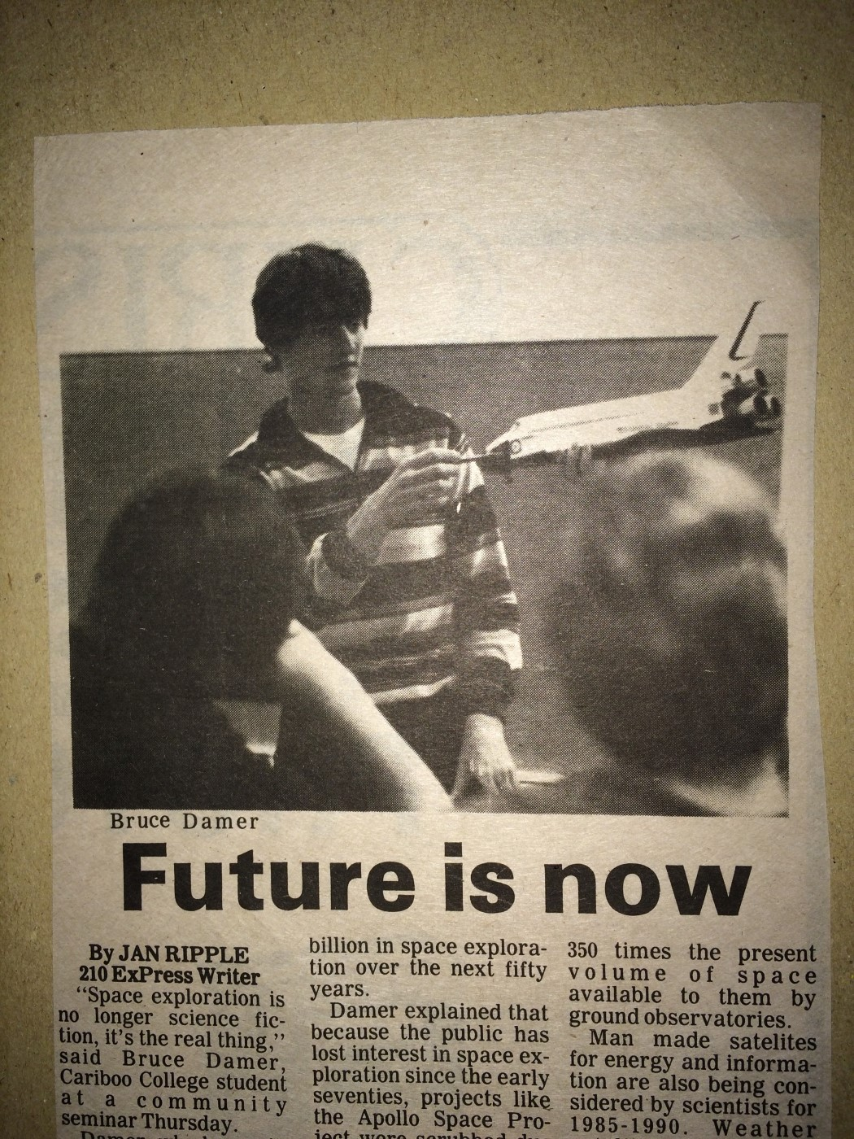
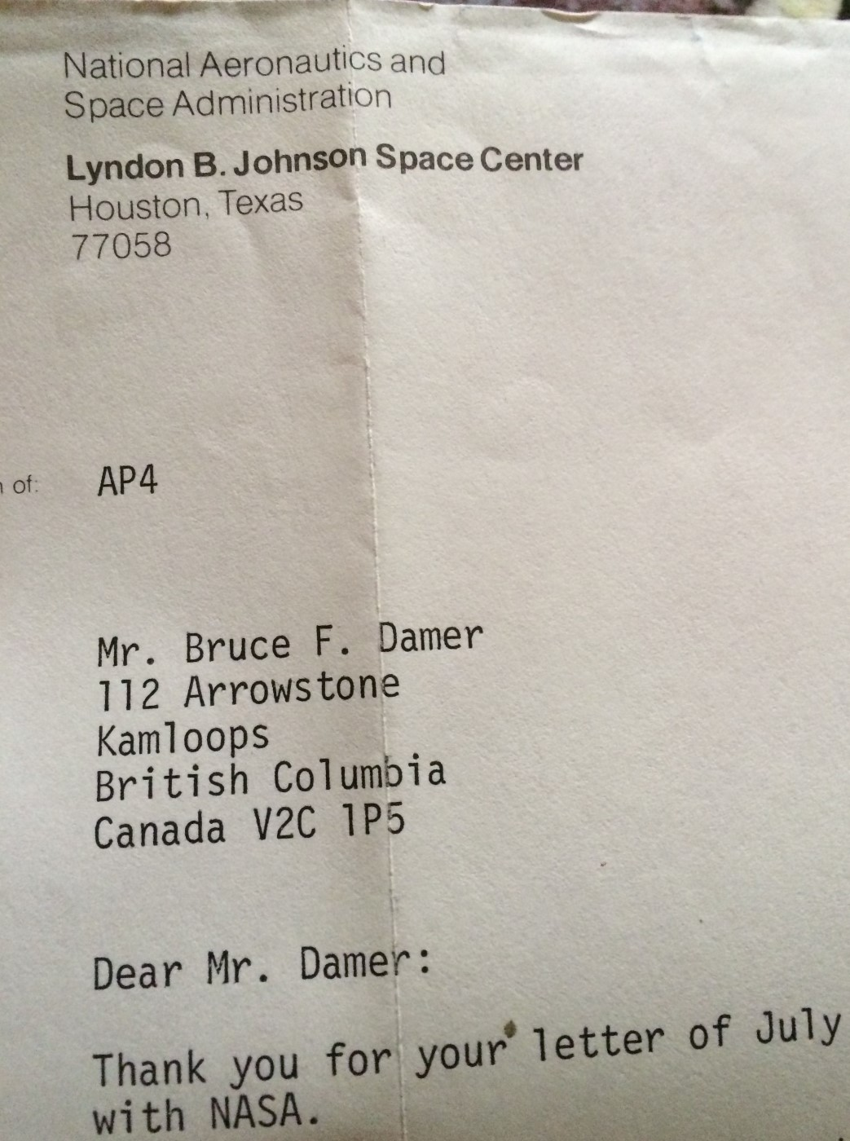
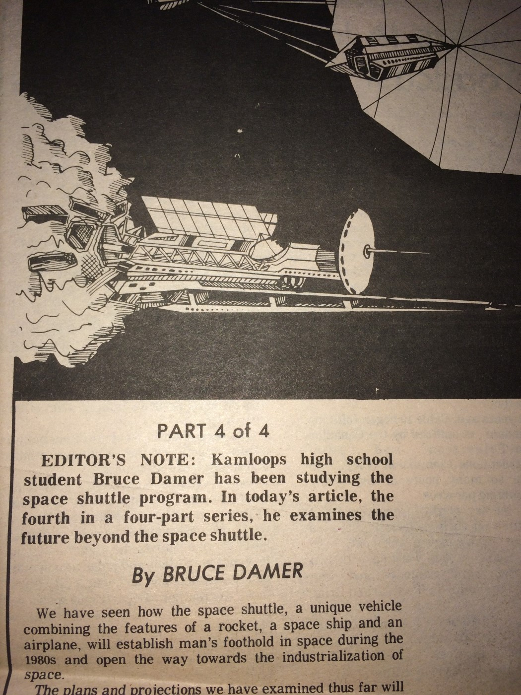
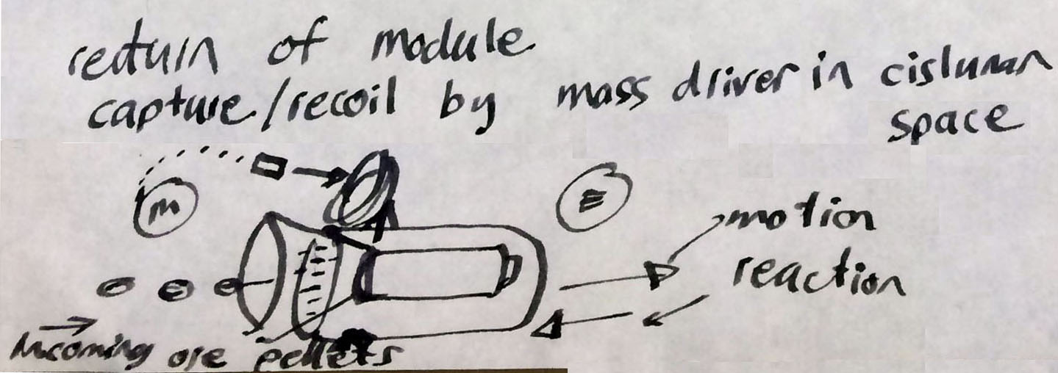

Slide 7
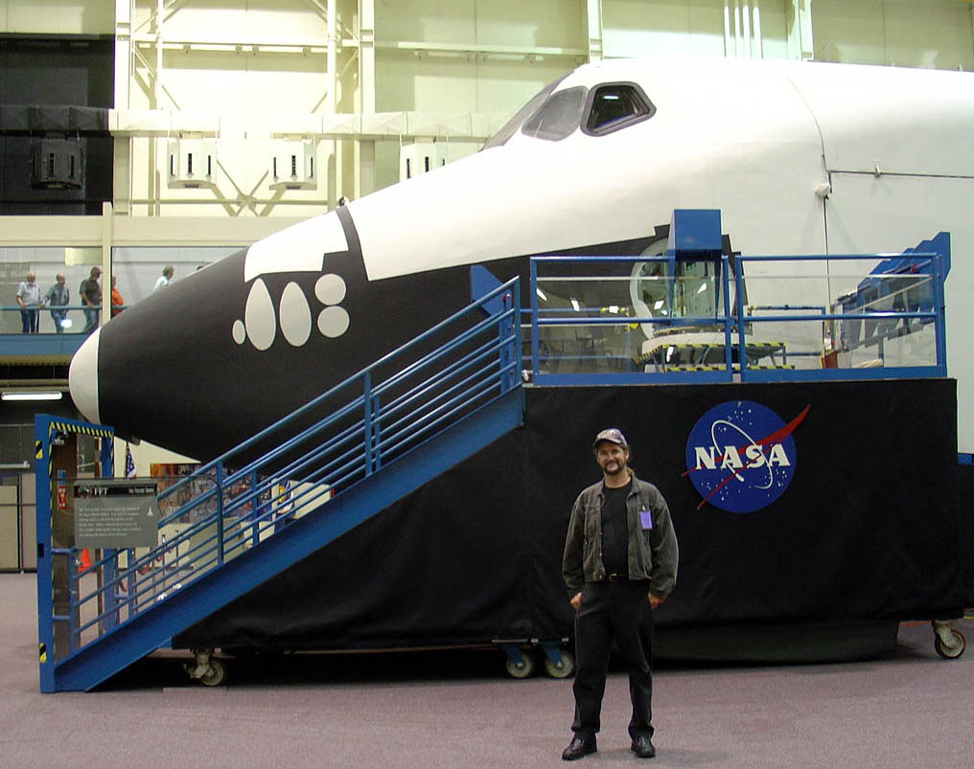
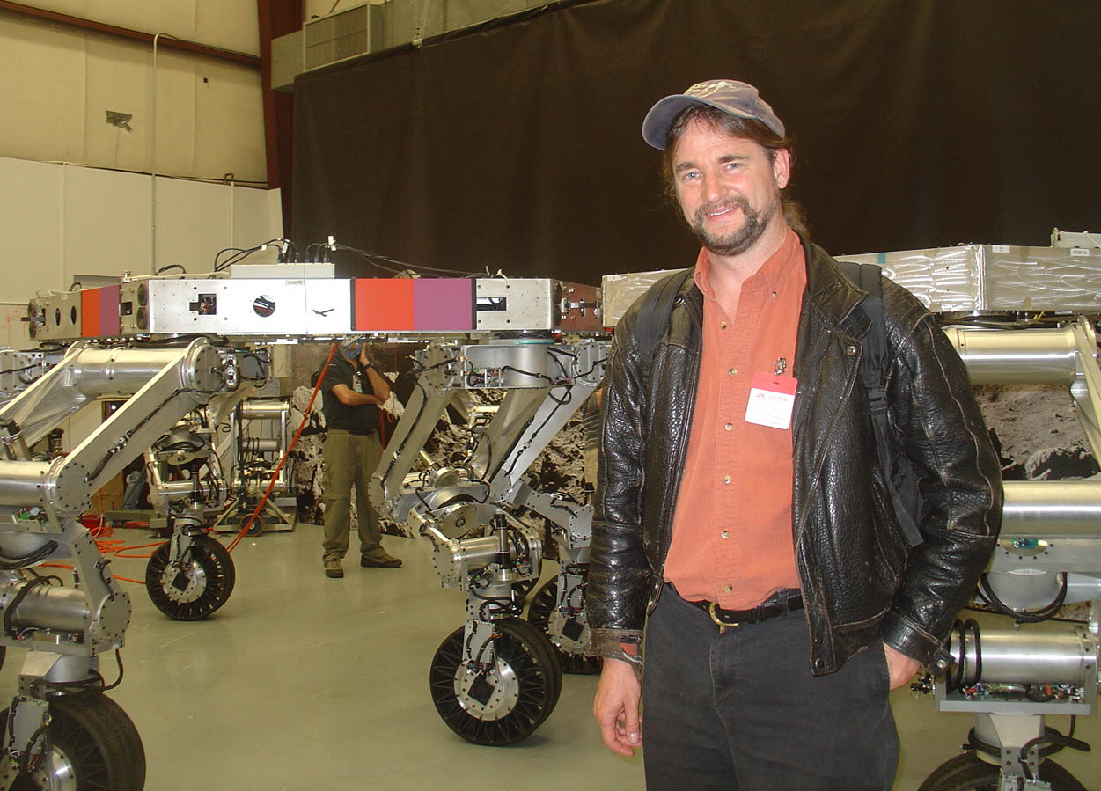
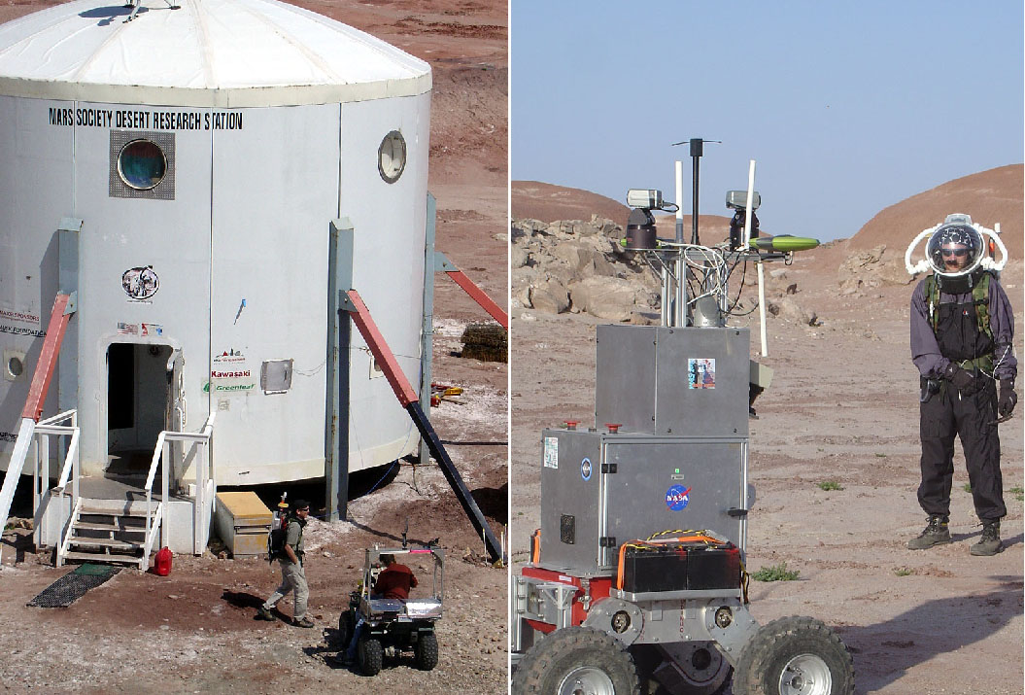

Slide 8
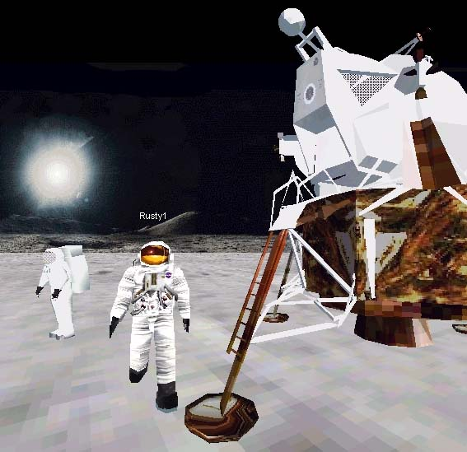
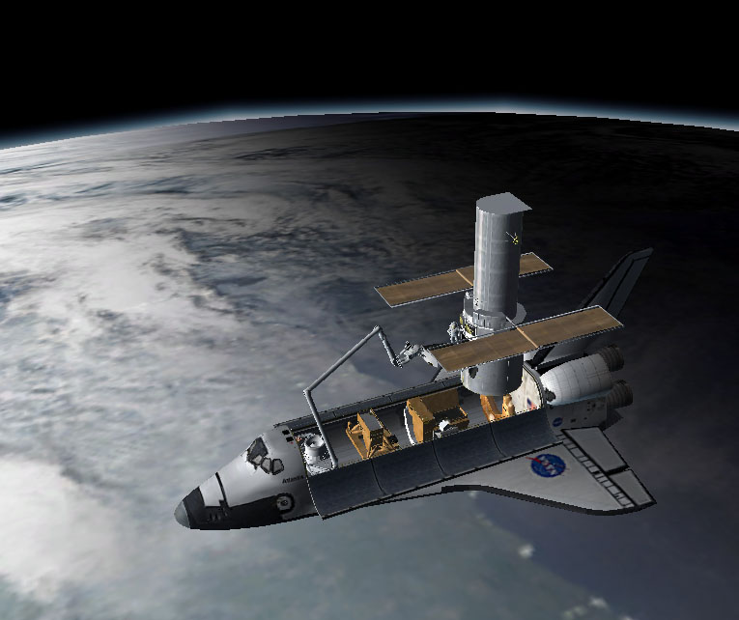
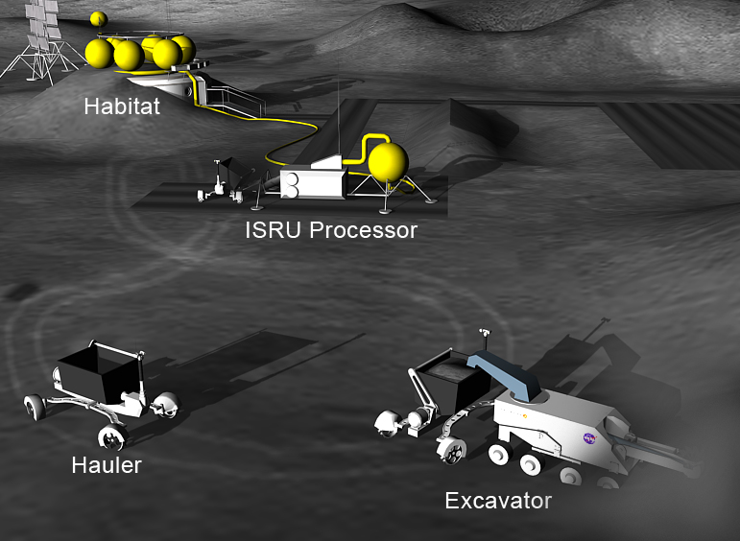
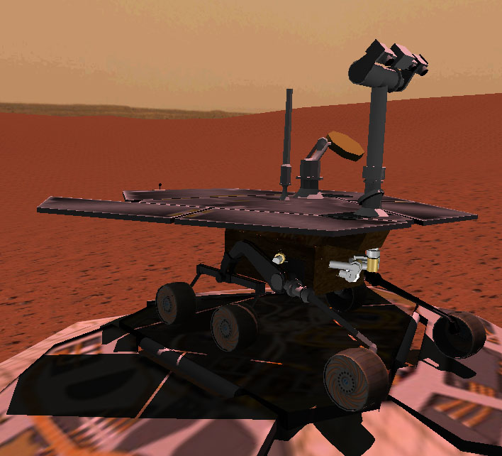
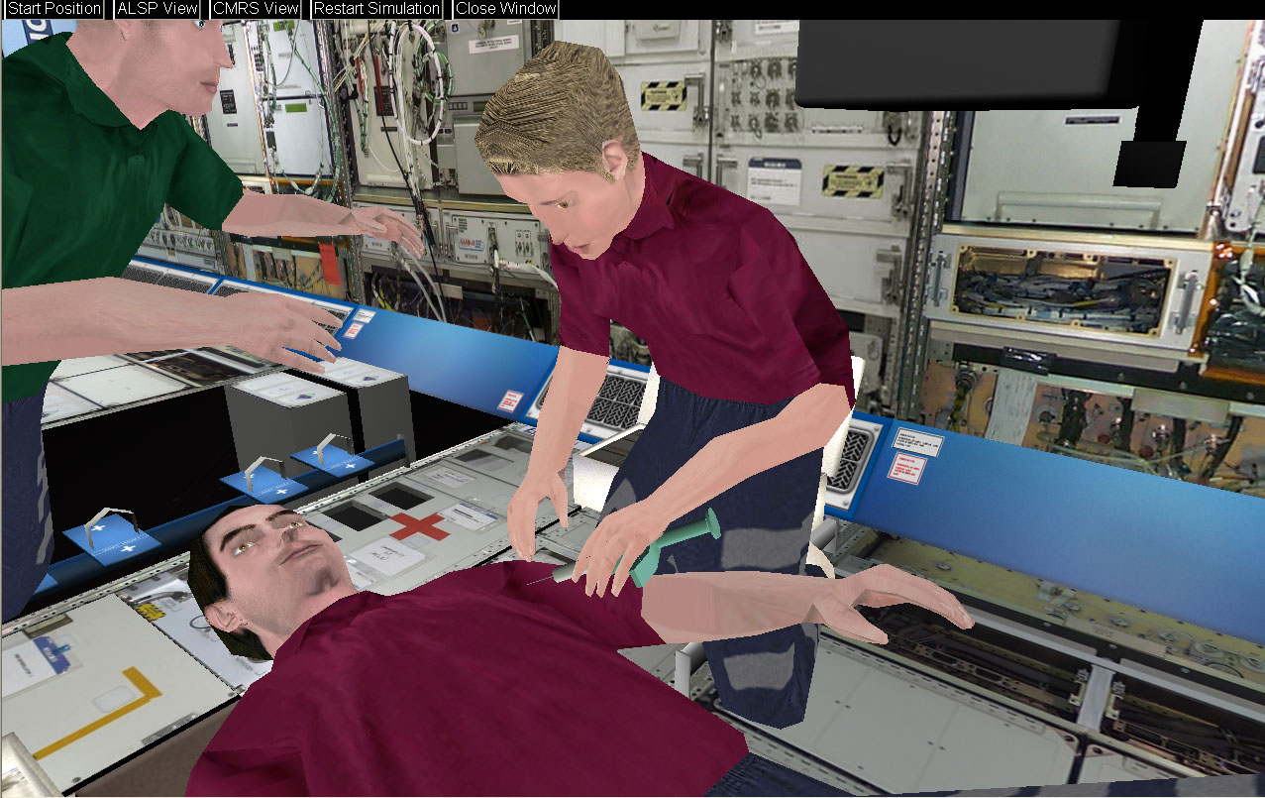

Slide 9
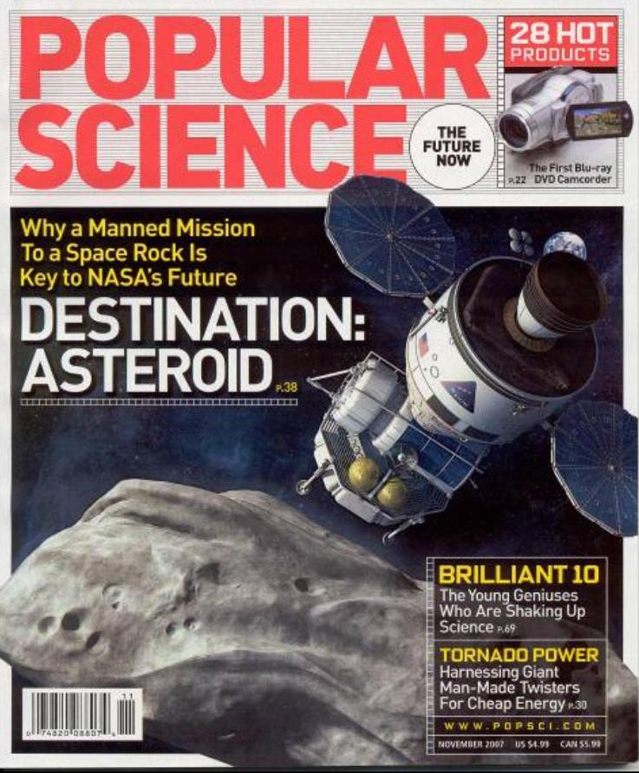
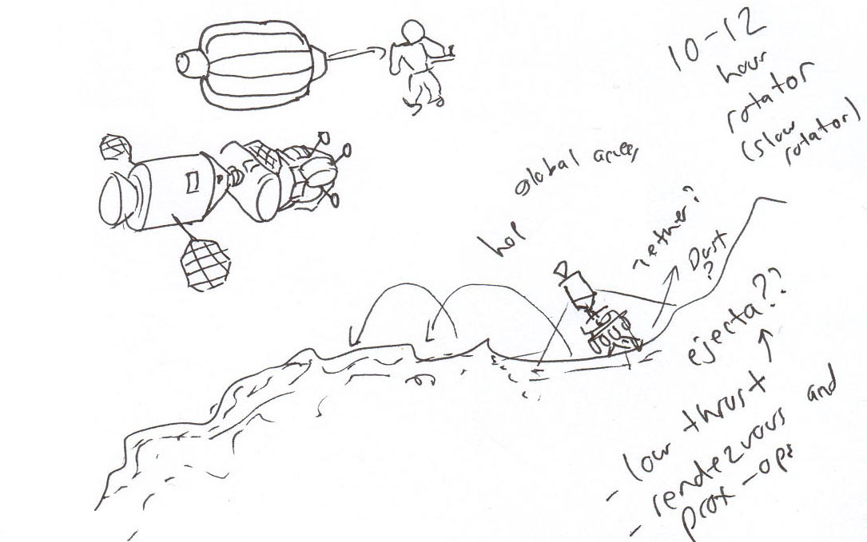

Slide 10
Part Two…
The Next Step

Slide 11
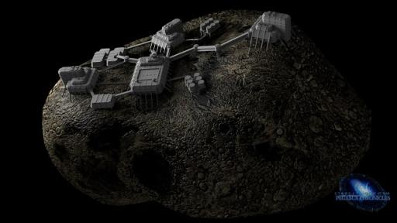
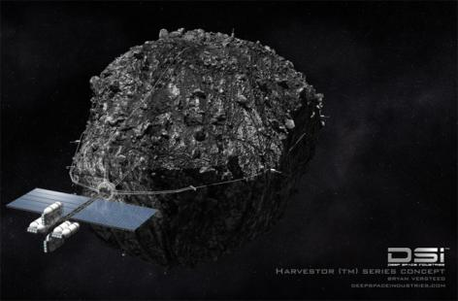
Asteroid mining?
Problems: Low gravity!
Asteroids may fall apart
Debris goes everywhere
Diverse, heavy equipment
Teleoperations problematic
$$$cost + risk

Slide 12

Asteroid mining?
Problems: Low gravity!
Asteroids may fall apart
Debris goes everywhere
Diverse, heavy equipment
Teleoperations problematic
$$$cost + risk

Slide 13
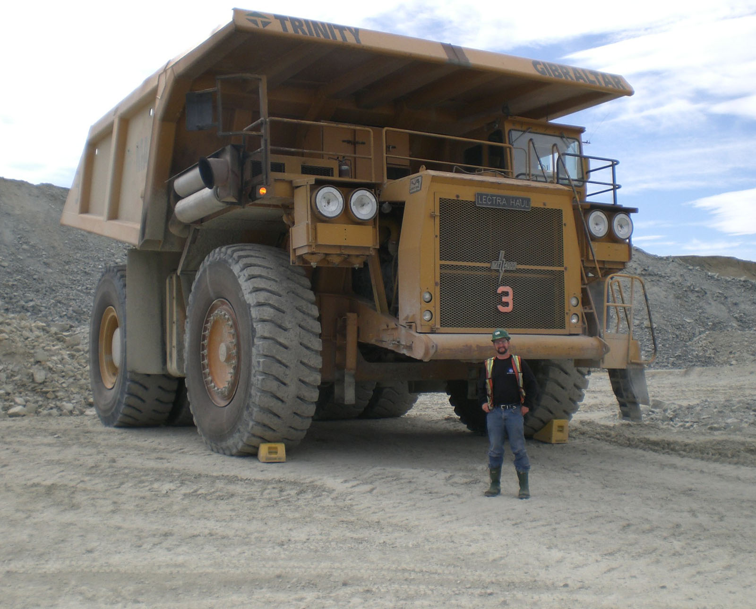
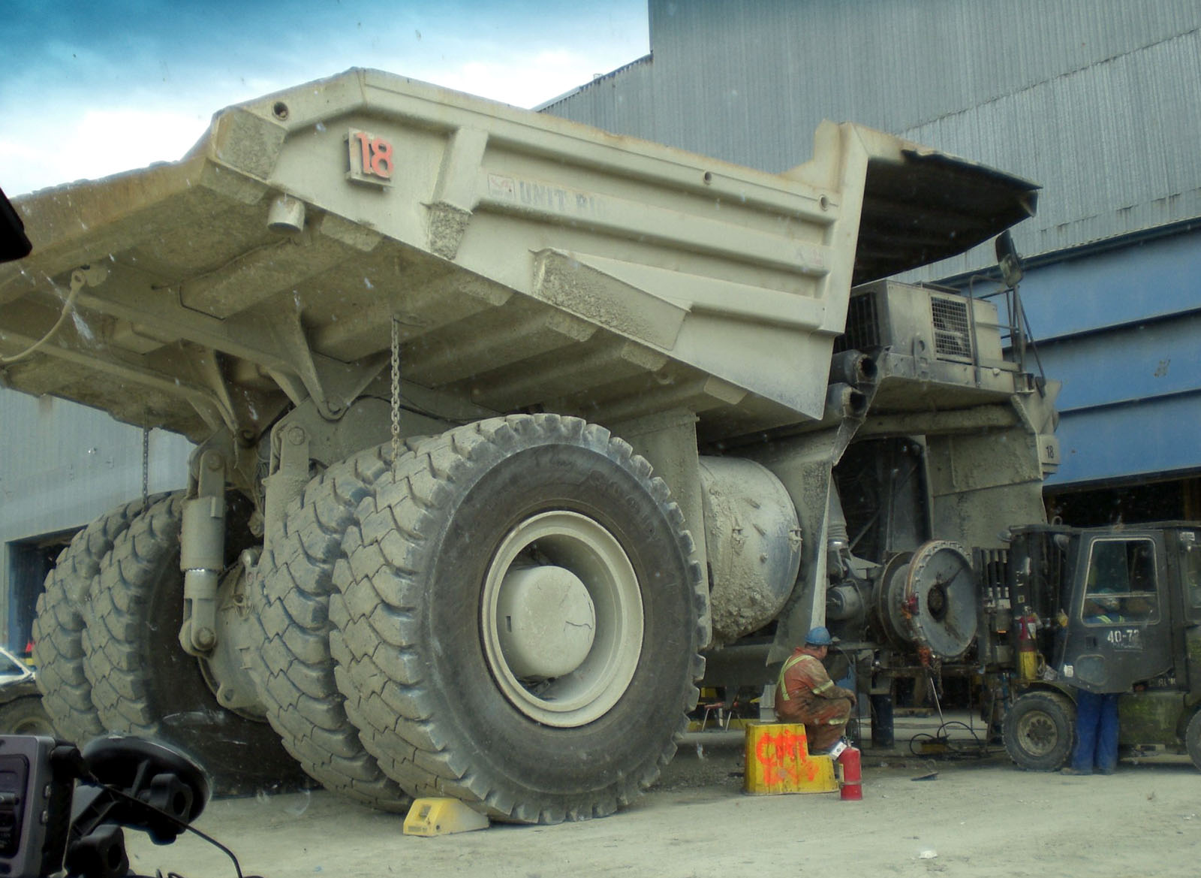
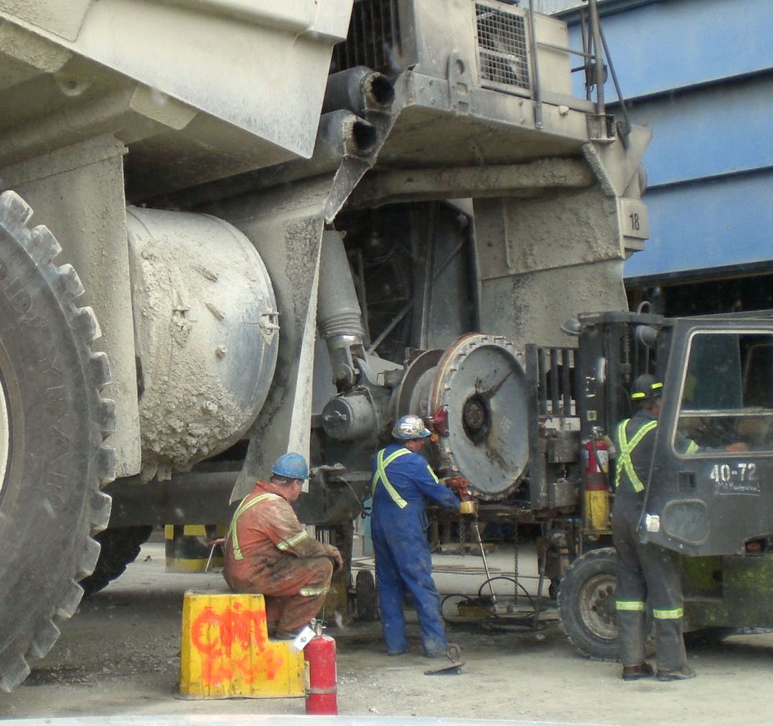
Terrestrial mining

Slide 14
Part Three…
Steps to Invention

Slide 15
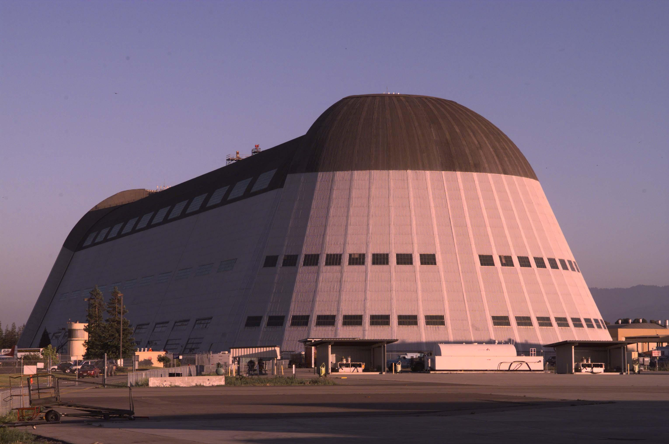
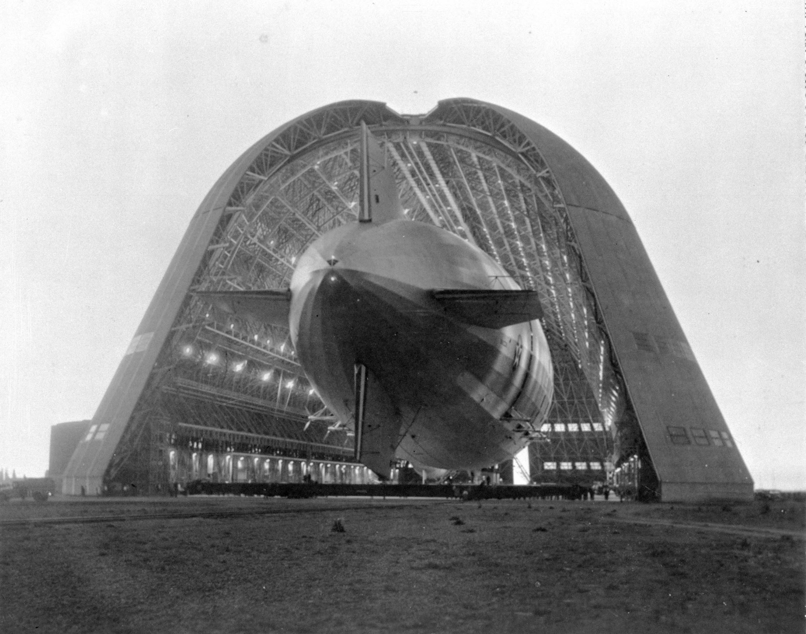
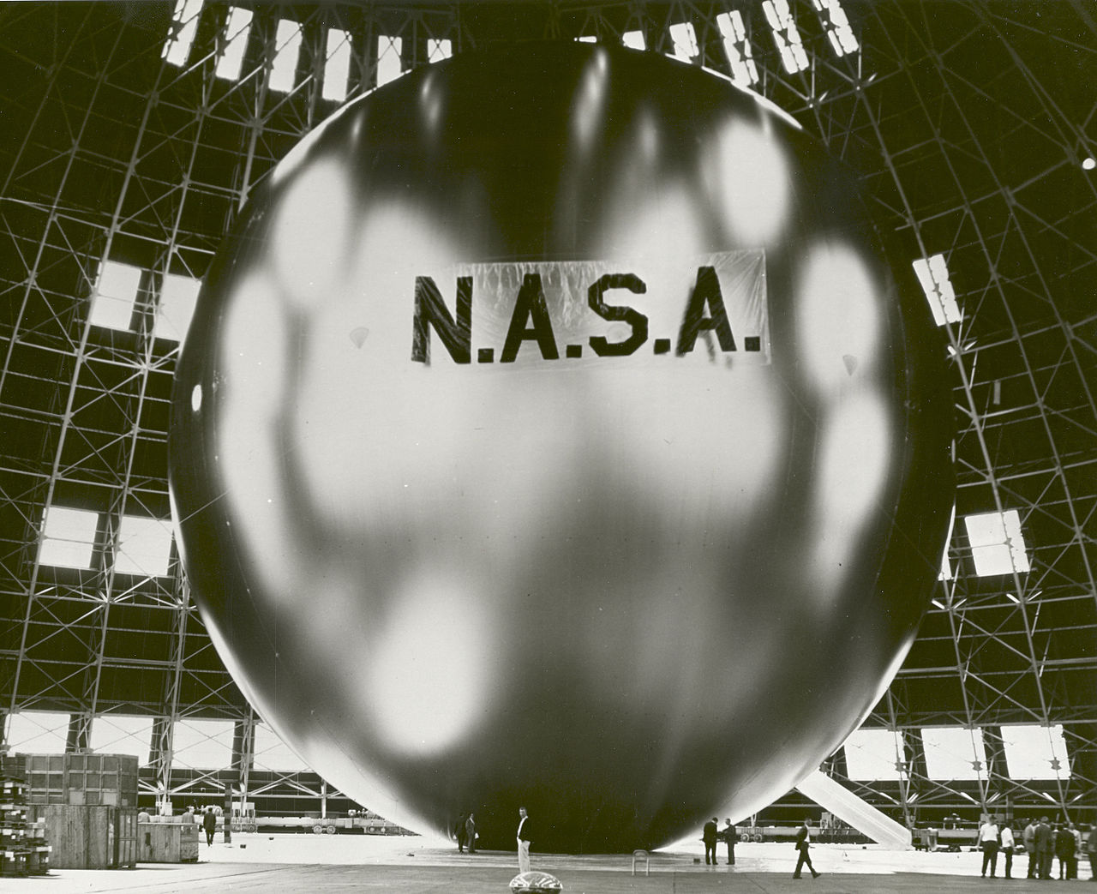

Slide 16
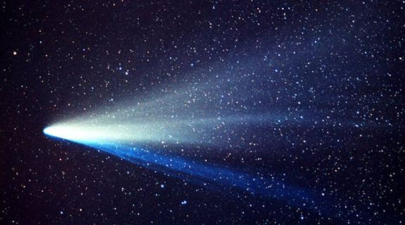

Slide 17
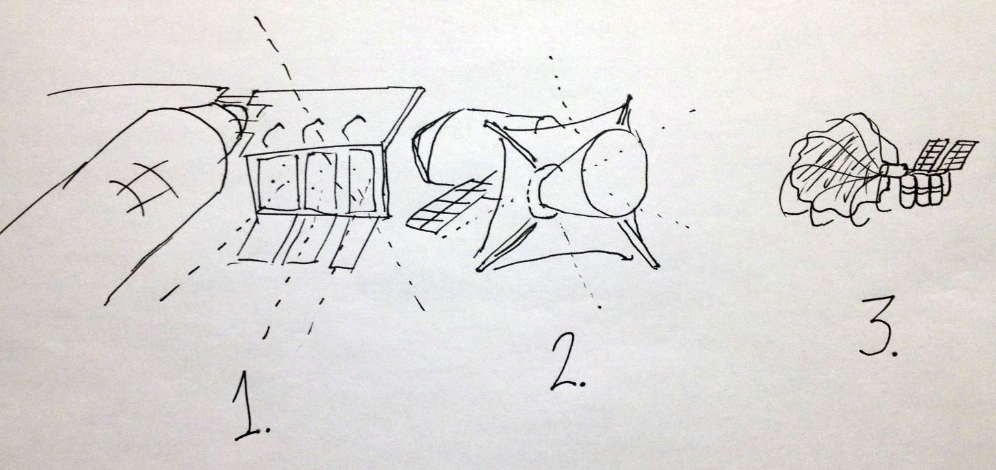
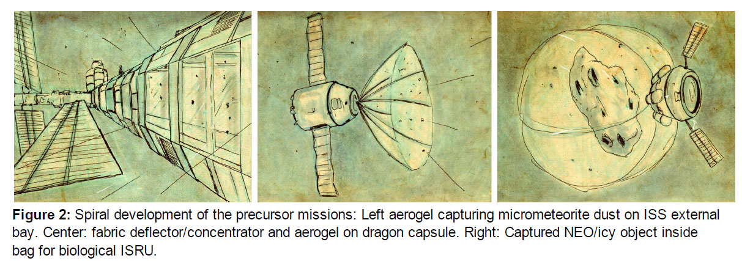
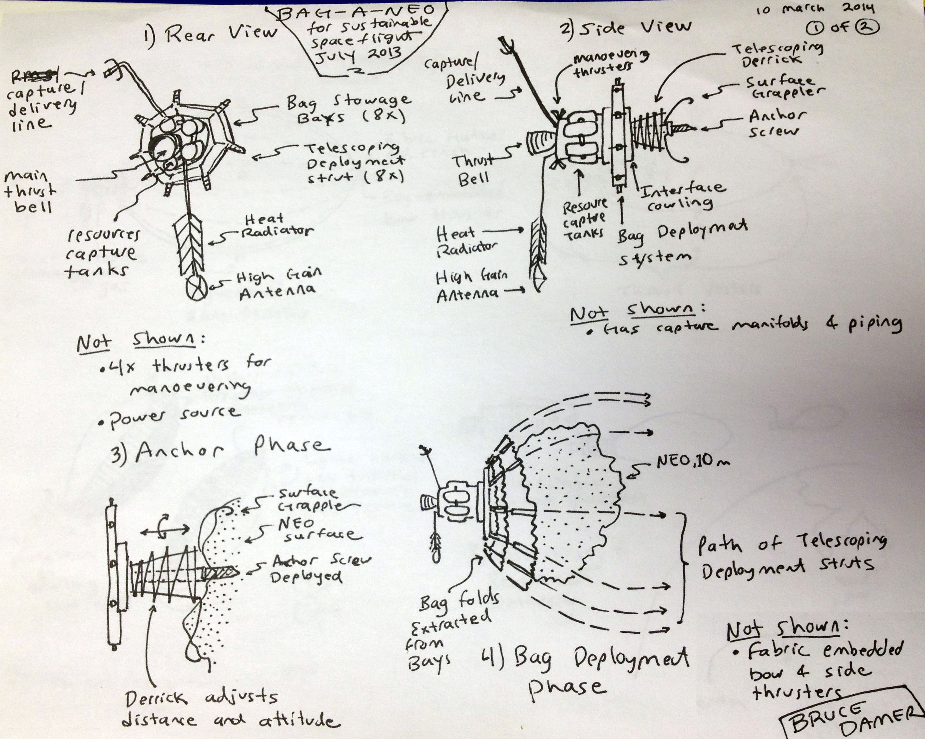

Slide 18
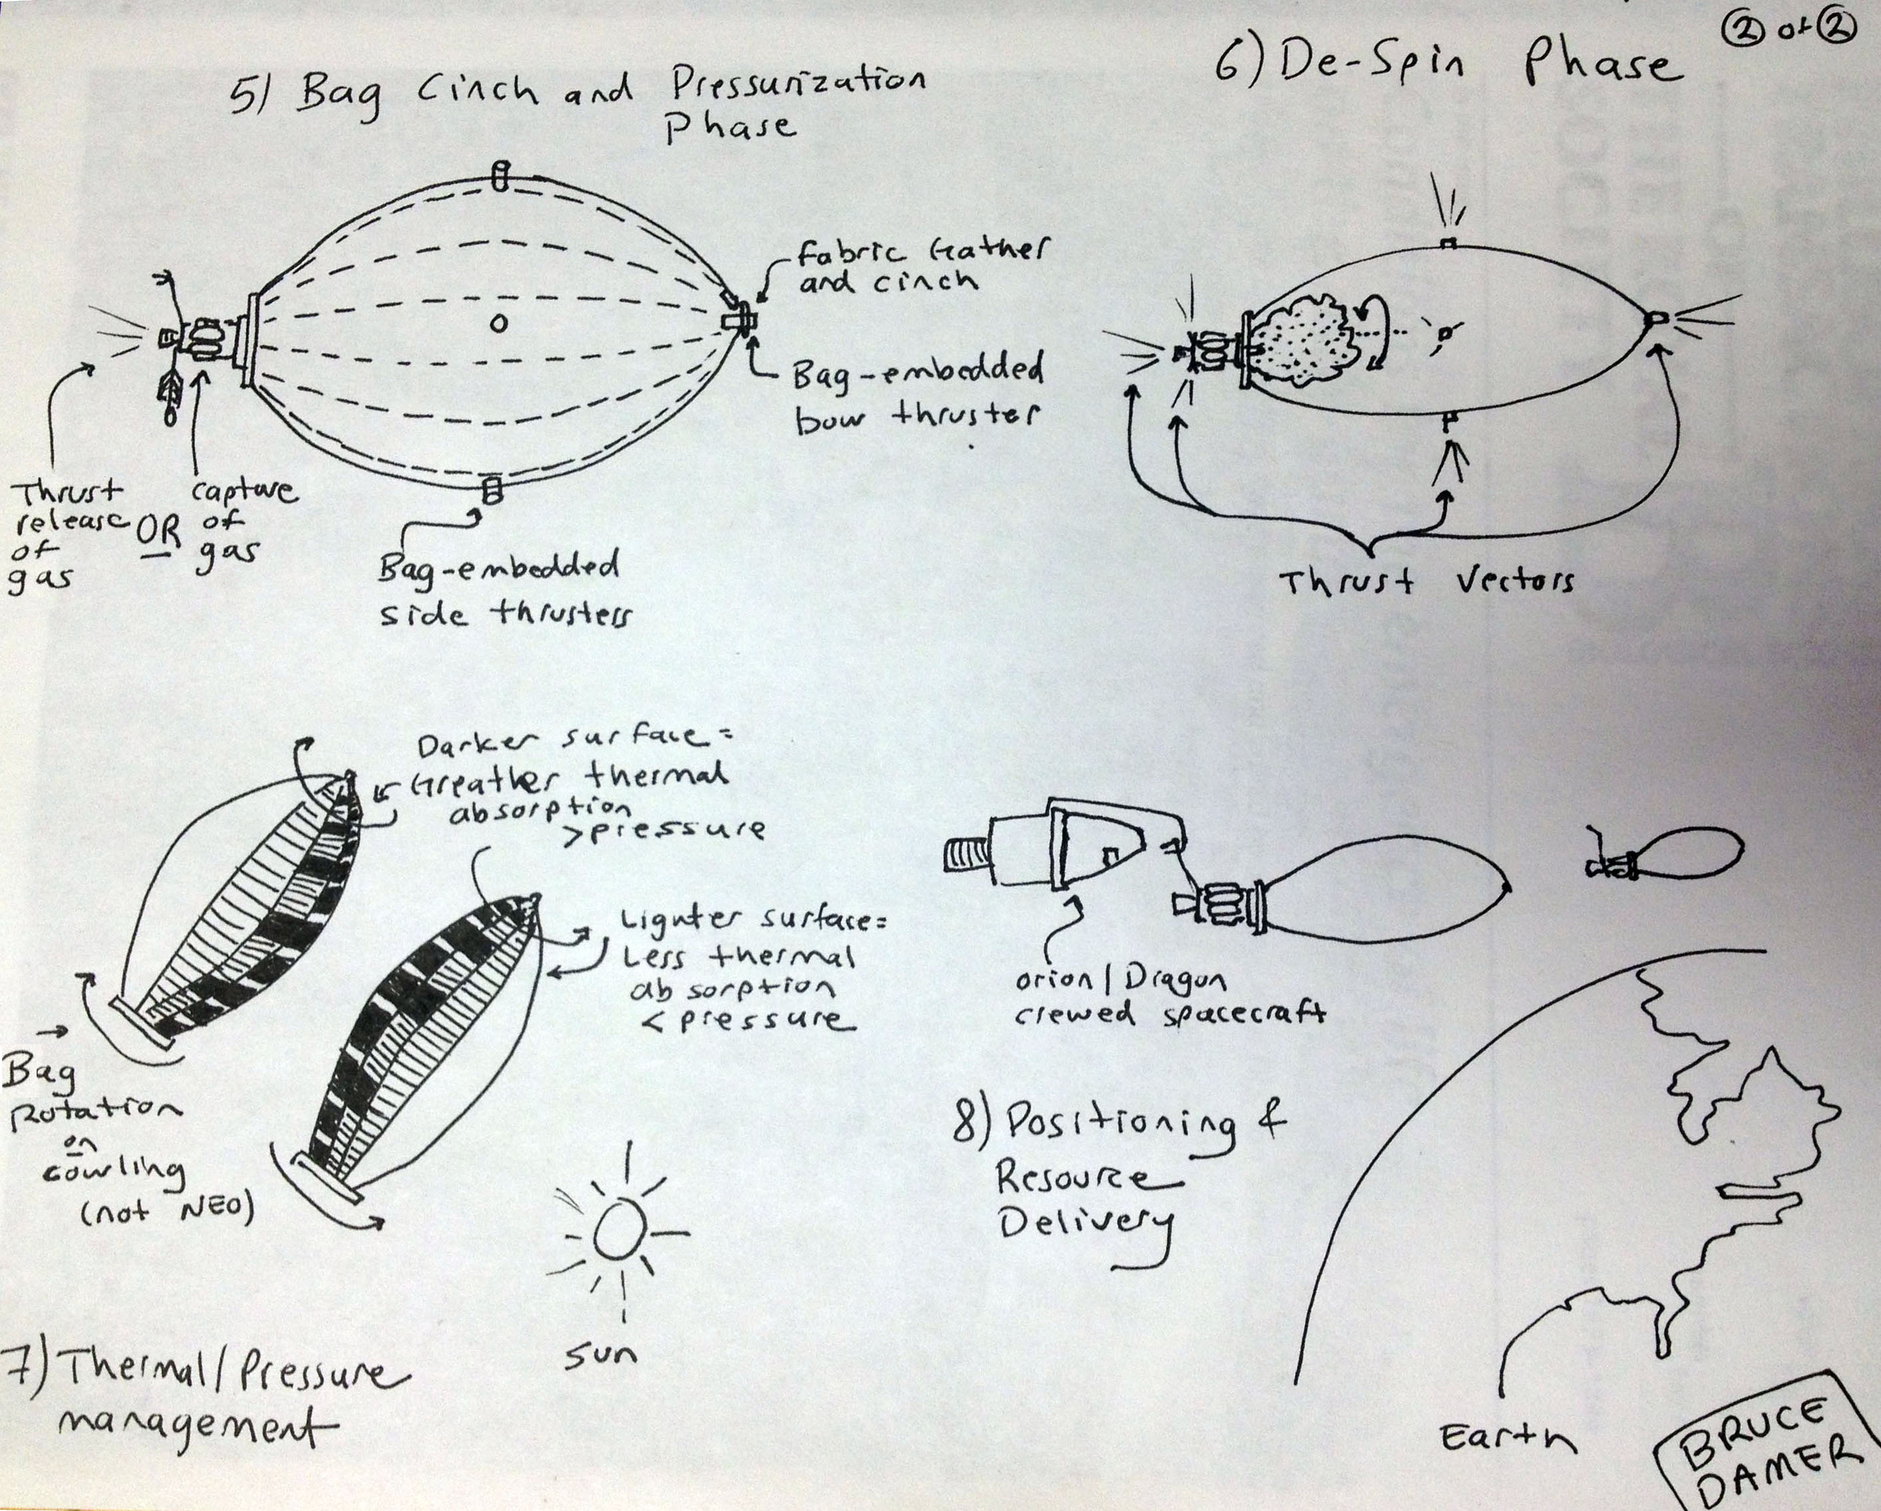

Slide 19
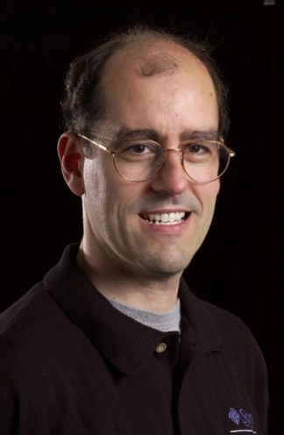
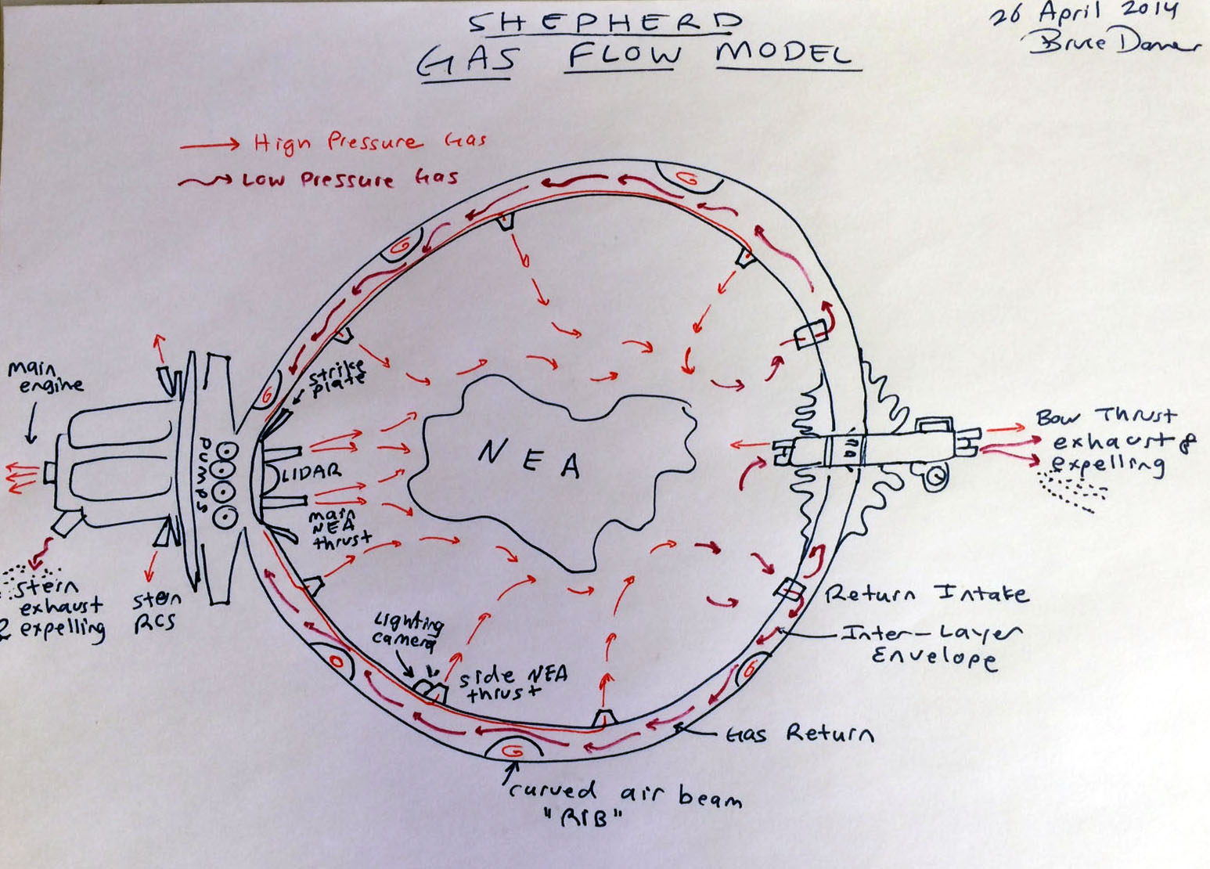
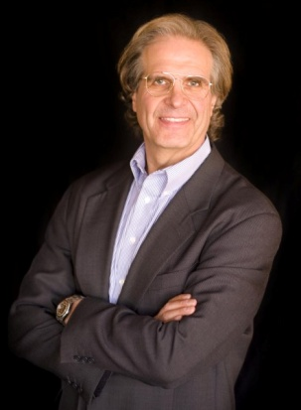
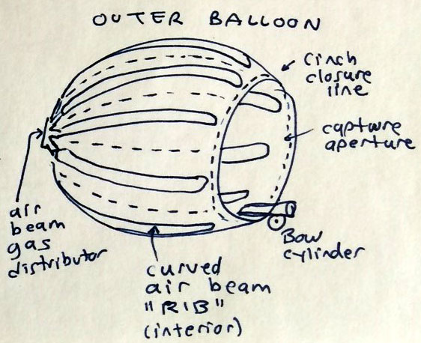

Slide 20
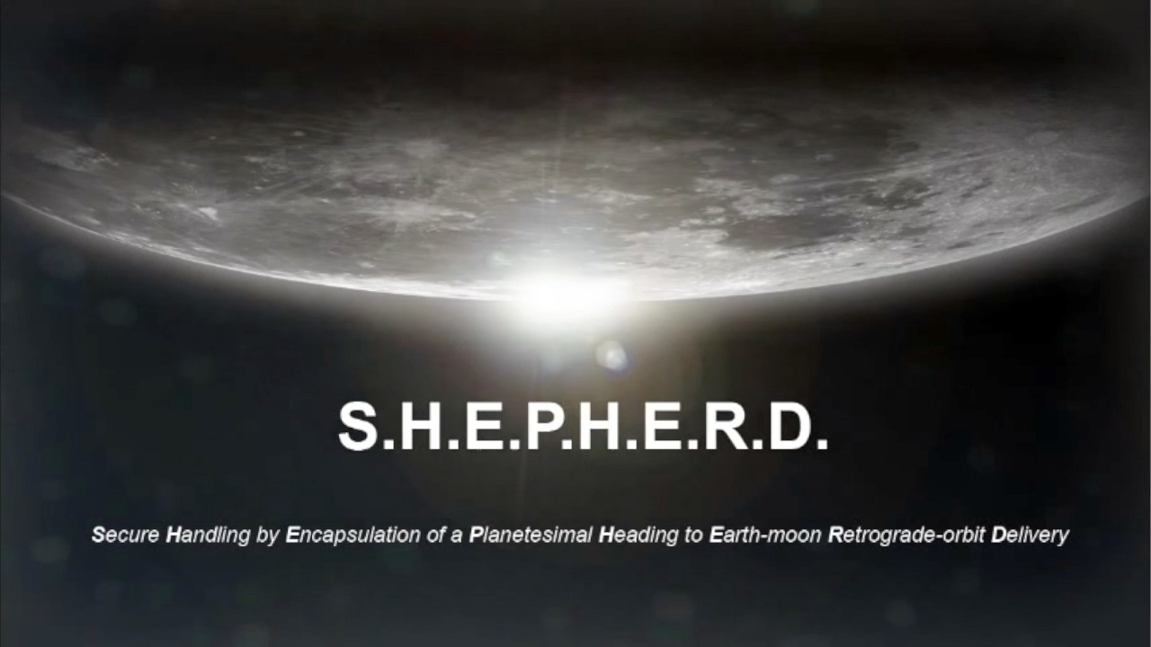

Slide 21
Part Four…
Practical Steps

Slide 22
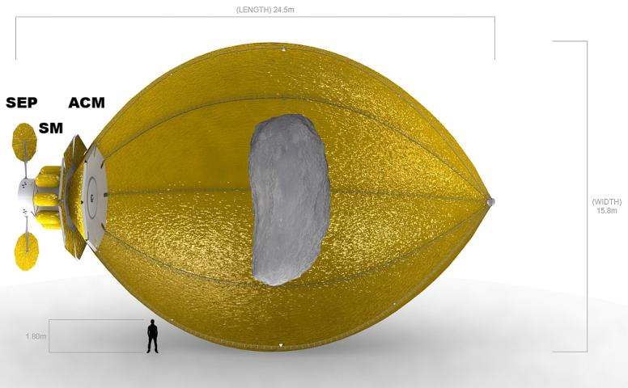
SHEPHERD: capture & handling
Turbulent dissipation of angular momentum: 7–70h
2 ton Xe
10 ton
tumbling

Slide 23
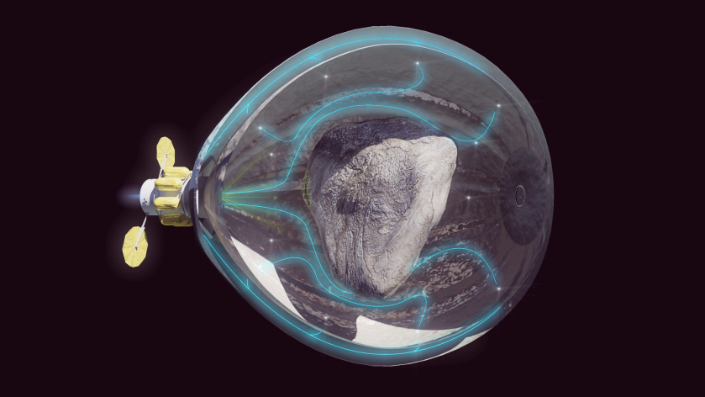
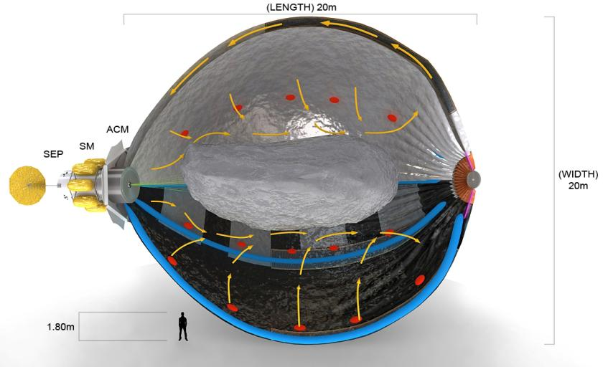
SHEPHERD: capture & handling
Driving Phase: gas flow and recycling
10 ton
tumbling

Slide 24
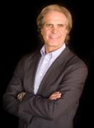
15-m ø, 0.1 atm balloon (ULD1)

Slide 25
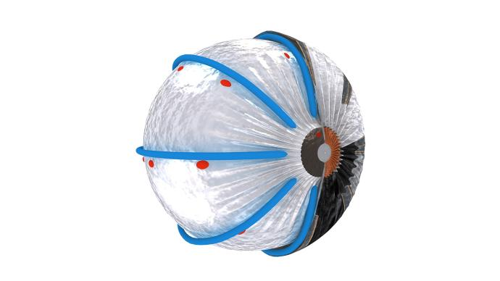
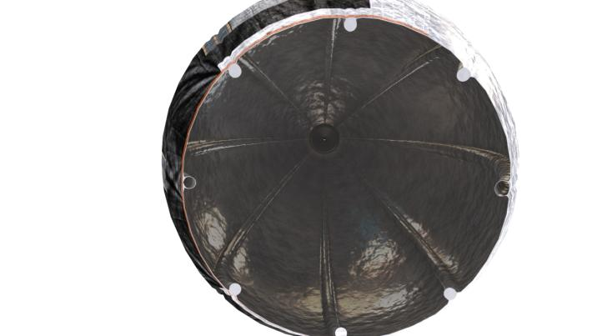
SHEPHERD: soft structure vs rigid
Outer and inner envelopes separated by air beams supporting ductwork and blisters with lighting, cameras

Slide 26
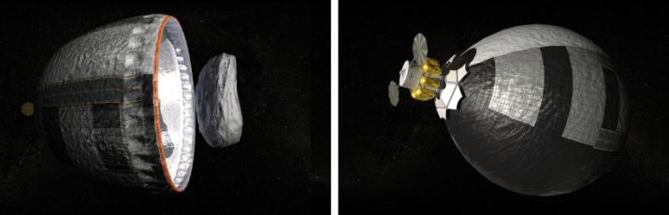
Asteroid capture

Slide 27
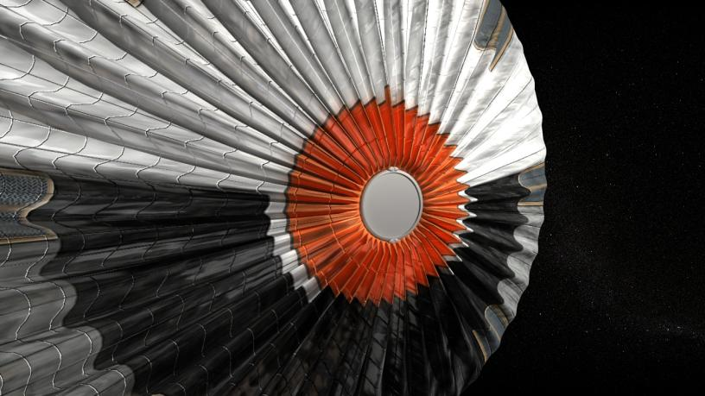
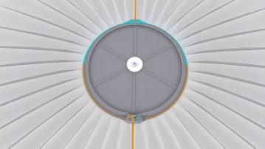

Key issue: how to seal enclosure

Slide 28

Other issues: power generation, thermal management

Slide 29

Autonomous control LIDAR for proxops

Slide 30


Blister: thruster, return vent, lighting, camera

Slide 31
Part Five…
Stepping Out

Slide 32


Types of targets, missions
Credit: ESA/Rosetta/NAVCAM
Credit: WIkimedia commons

Slide 33



Lunar Orbit Delivery for Science

Slide 34


Economic low-hanging fruit: Volatiles

Slide 35


Slide 36

Metals extraction: Gas mining
3D printer in space

Slide 37

Biospheres for harvesting consumables

Slide 38

Game-changing architecture at work

Slide 39

Game-changing architecture at work

Slide 40

Game-changing architecture at work

Slide 41

Game-changing architecture at work

Slide 42

Game-changing architecture at work

Slide 43

Completely new way to go to Mars

Slide 44

Viable solar system economic market

Slide 45

Building permanent space habitats

Slide 46

Building permanent space habitats

Slide 47

Supplying permanent space habitats

Slide 48
Part Six…
The First Steps

Slide 49
The Business Model
-Science (asteroid return, sampling, Mars)
-Fuel stations, consumables, shielding
-Space Tourism
-Rare metals
-Individual initiative
-…
-Population and resource pressures (>2100AD)
-Large scale habitation, Solar System ecosphere

Slide 50
The Business Model
-Science (asteroid return, sampling, Mars)
-Fuel stations, consumables, shielding
-Space Tourism
-Rare metals
-Individual initiative
-…
-Population and resource pressures (>2100AD)
-Large scale habitation, Solar System ecosphere

Slide 51

Individual initiative:
Isambard Kingdom Brunel
Credit: Wikimedia Commons

Slide 52




A revolution in transportation in the 19th Century
Credit: Wikimedia Commons, Julian Nott, EarlyAmericanAutomobiles.com

Slide 53


Individual: Elon Musk
Credits: Web Summit, Tesla, SpaceX

Slide 54
The Business Plan: 20+ years
-Team of Damer, Jenniskens, Nott, et al. advising-NewSpace consortium, governments executing

Slide 55
The Business Plan: 20+ years
-Team of Damer, Jenniskens, Nott, et al. advising-NewSpace consortium, governments executing
-“Spiral” development 1-10m$ per year, 10 years:
  2 meter scale prototype: vacuum chamber testing
  Cubesat demonstrator: low earth orbit
  ISS demonstrator: FETCH-1 mission
  FETCH-2 to GeoSat, servicing missions
  FETCH-3 to Trojan Object for science
  Recon+SHEPHERD-1 to small asteroid for science

Slide 56
The Business Plan: 20+ years
-Team of Damer, Jenniskens, Nott, et al. advising-NewSpace consortium, governments executing
-“Spiral” development 1-10m$ per year, 10 years:
  2 meter scale prototype: vacuum chamber testing
  Cubesat demonstrator: low earth orbit
  ISS demonstrator: FETCH-1 mission
  FETCH-2 to GeoSat, servicing missions
  FETCH-3 to Trojan Object for science
  Recon+SHEPHERD-1 to small asteroid for science
-“Go for it” development 100m$+/year 10 years:
  SHEPHERD Deep Space > orbit of Mars
  SHEPHERD-Fuel for LEO, CisLunar, Mars
  SHEPHERD-Miner and -Bio trials

Slide 57




Slide 58

Thank you
Contact:
Bruce Damer (DigitalSpace): bdamer@digitalspace.com
Peter Jenniskens (SETI Institute): petrus.m.jenniskens@nasa.gov

